Slide 1
STRING DATATYPE
Operations on

Slide 2
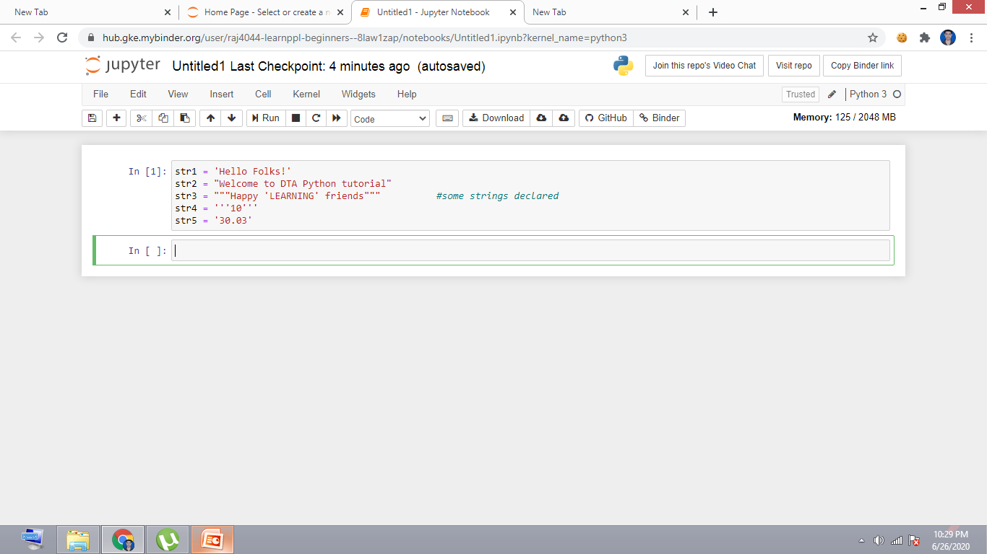
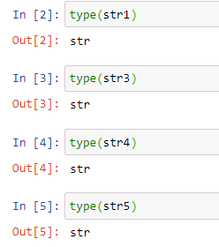
Declare some words/sentences & check their datatypes

Slide 3
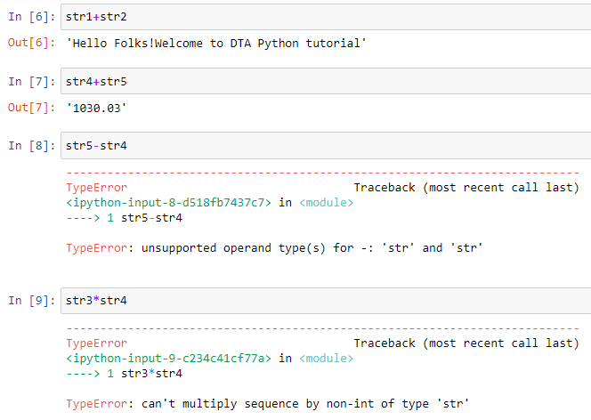
Arithmetic Operations on str

Slide 4
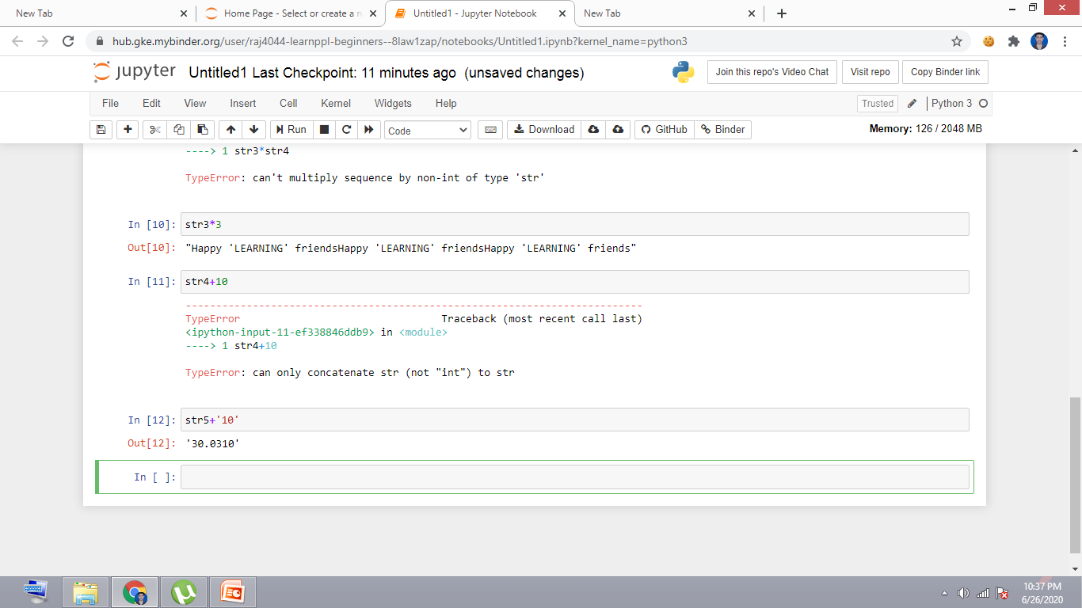
Arithmetic Operations on str

Slide 5
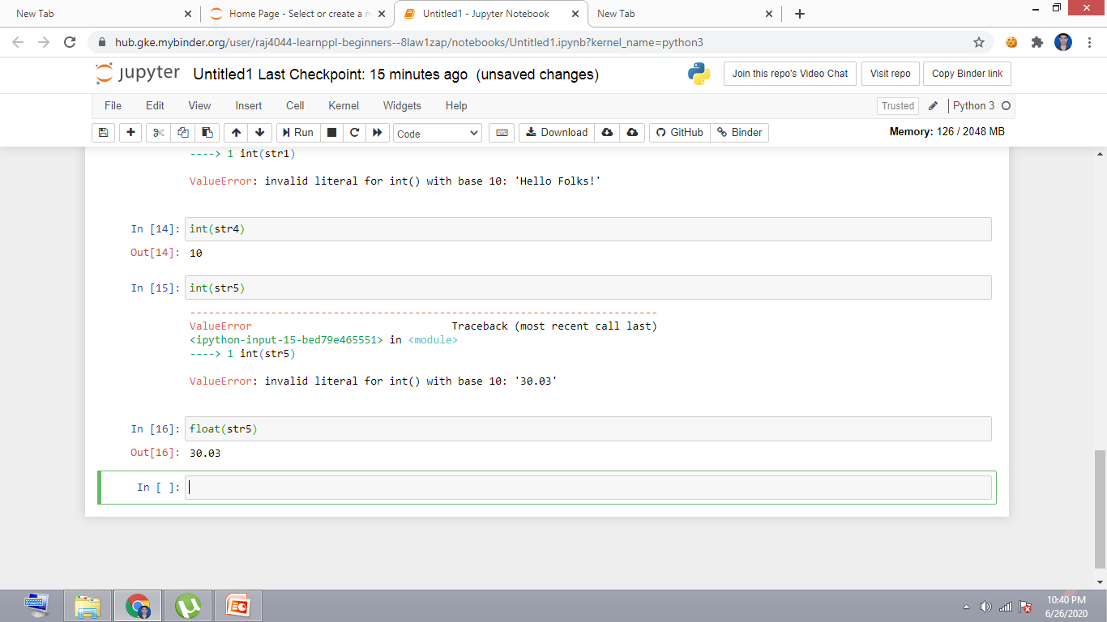
Conversion from str to numeric datatype

Slide 6
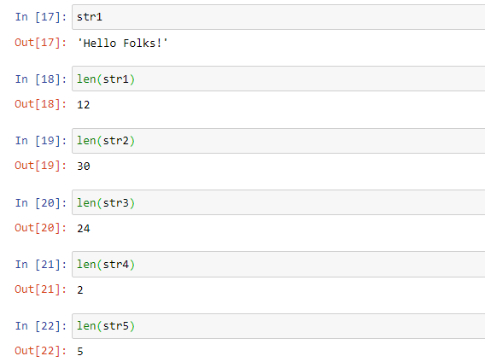
Special Operations

Slide 7
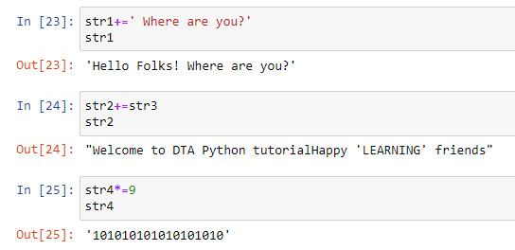
Assignment Operation

Slide 8
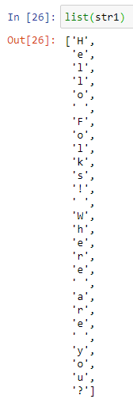
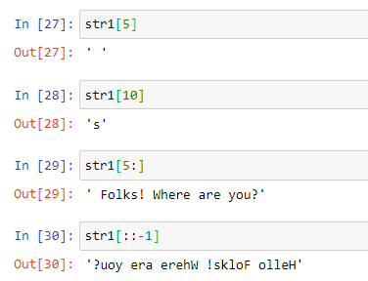
String behaves as list?

Slide 9
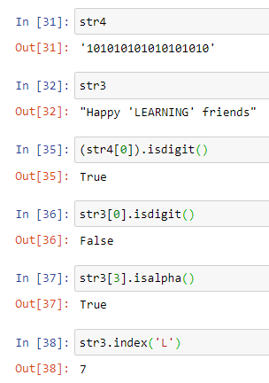
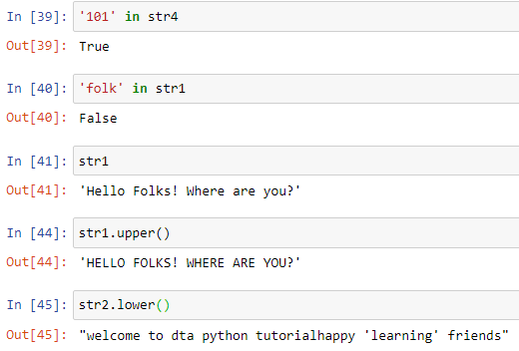
Check Operations

Slide 10
Tell us
Do you know some Python list operations?
If yes:
Comment below
If no:
Wait for the next lecture
Subscribe

